Slide 1
Chapter 17: Wireless Signals and Modulation
Instructor Materials
CCNP Enterprise: Core Networking

Slide 2
Chapter 17 Content
This chapter covers the following content:
Understanding Basic Wireless Theory - This section covers the basic theory behind radiofrequency (RF) signals, as well as measuring and comparing the power of RF signals.
Carrying Data over a Wireless Signal - This section provides an overview of basic methods and standards that are involved in carrying data wirelessly between devices and the network.
Notes:
10 – Basic Router Configuration
10.1 – Configure Initial Router Settings
10.1.4 – Packet Tracer – Configure Initial Router Settings

Slide 3
Understanding Basic Wireless Theory
Wireless signals travel as electromagnetic waves through the air from sender to receiver.
Frequency is a fundamental property of the waves involved in a wireless link.

Slide 4
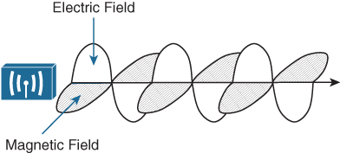
Understanding Basic Wireless Theory Basic Wireless Concepts
In RF wireless communications, the sender (a transmitter) sends an alternating current into a section of wire (an antenna), which sets up moving electric and magnetic fields that propagate out and away from the antenna as traveling waves.
The electric and magnetic fields travel along together and are always at right angles to each other, as shown in Figure 17-3. The signal must keep changing, or alternating, by cycling up and down, to keep the electric and magnetic fields cycling and pushing ever outward.
Electromagnetic waves do not travel strictly in a straight line. Instead, they travel by expanding in all directions away from the antenna.
In free space, the electromagnetic waves expand outward in all three dimensions.
Figure 17-3 Traveling Electric and Magnetic Waves

Slide 5
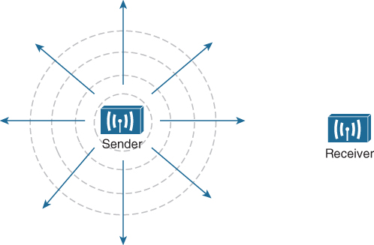
Understanding Basic Wireless Theory Basic Wireless Concepts (Cont.)
The waves produced from a tiny point antenna expand outward in a spherical shape. The waves will eventually reach the receiver, in addition to many other locations in other directions.
Figure 17-4 shows a simple idealistic antenna that is a single point, which is connected at the end of a wire at the sender.
At the receiving end of a wireless link, the process is reversed. As the electromagnetic waves reach the receiver’s antenna, they induce an electrical signal. If everything works right, the received signal will be a reasonable copy of the original transmitted signal.
Figure 17-4 Wave Propagation with an Idealistic Antenna

Slide 6
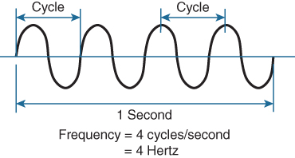
Understanding Basic Wireless Theory Understanding Frequency
The waves involved in a wireless link can be measured and described in several ways. One fundamental property is the frequency of the wave, or the number of times the signal makes one complete up and down cycle in 1 second.
A cycle can begin as the signal rises from the center line, falls through the center line, and rises again to meet the center line.
A hertz (Hz) is the most commonly used frequency unit and corresponds to the number of cycles per second.
In Figure 17-5, suppose that 1 second has elapsed, as shown. During that 1 second, the signal progressed through four complete cycles. Therefore, its frequency is 4 cycles/second, or 4 hertz.
Figure 17-5 Cycles Within a Wave

Slide 7
Understanding Basic Wireless Theory Frequency Unit Names
Frequency can vary over a very wide range. As frequency increases by orders of magnitude, the numbers can become quite large. To keep things simple, the frequency unit name can be modified to denote an increasing number of zeros, as listed in Table 17-2.
Table 17-2 Frequency Unit Names
Unit | Abbreviation | Meaning
Hertz | Hz | Cycles per second
Kilohertz | kHz | 1000 Hz
Megahertz | MHz | 1,000,000 Hz
Gigahertz | GHz | 1,000,000,000 Hz

Slide 8
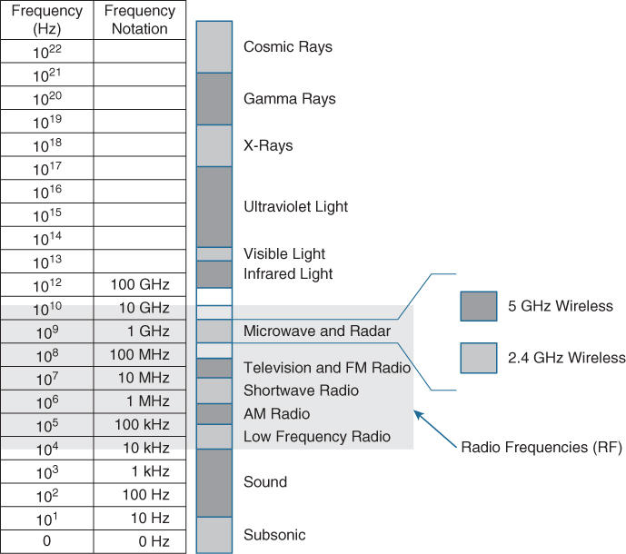
Understanding Basic Wireless Theory Continuous Frequency Spectrum
Figure 17-6 shows a simple representation of the continuous frequency spectrum ranging from 0 Hz to 10²² (or 1 followed by 22 zeros) Hz. At the low end of the spectrum are frequencies that are too low to be heard by the human ear, followed by audible sounds. The highest range of frequencies contains light, followed by X, gamma, and cosmic rays.
The frequency range from around 3 kHz to 300 GHz is commonly called radio frequency (RF). It includes many different types of radio communication, such as low-frequency radio, AM radio, shortwave radio, television, FM radio, microwave, and radar.
Figure 17-6 Continuous Frequency Spectrum

Slide 9
Understanding Basic Wireless Theory Frequency Bands for Wireless LANs
One of the two main frequency ranges used for wireless LAN communication lies between 2.400 and 2.4835 GHz. This is usually called the 2.4 GHz band, even though it does not encompass the entire range between 2.4 and 2.5 GHz.
The other wireless LAN range is usually called the 5 GHz band because it lies between 5.150 and 5.825 GHz. The 5 GHz band actually contains the following four separate and distinct bands:
5.150 to 5.250 GHz
5.250 to 5.350 GHz
5.470 to 5.725 GHz
5.725 to 5.825 GHz
Most of the 5 GHz bands are contiguous except for a gap between 5.350 and 5.470. At the time of this writing, this gap exists and cannot be used for wireless LANs.

Slide 10

Understanding Basic Wireless Theory Understanding Frequency - Channels
Frequency bands are usually divided up into a number of distinct channels. Each channel is known by a channel number and is assigned to a specific frequency. As long as the channels are defined by a national or international standards body, they can be used consistently in all locations.
Figure 17-7 shows the channel assignment for the 2.4 GHz band that is used for
wireless LAN communication. The band contains 14 channels numbered 1 through 14, each assigned a specific frequency.
Figure 17-7 Example of Channel Spacing in the 2.4 GHz Band

Slide 11
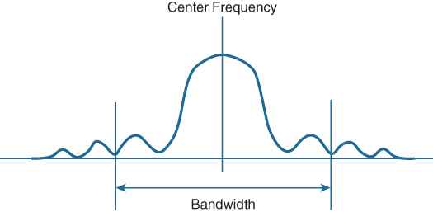
Understanding Basic Wireless Theory Understanding Frequency - Bandwidth
The actual frequency range needed for the transmitted signal is known as the signal bandwidth, as shown in Figure 17-8. As its name implies, bandwidth refers to the width of frequency space required within the band.
In wireless LANs, the signal bandwidth is defined as part of a standard. Even though the signal might extend farther above and below the center frequency than the bandwidth allows, wireless devices will use something called a spectral mask to ignore parts of the signal that fall outside the bandwidth boundaries.
Figure 17-8 Signal Bandwidth

Slide 12
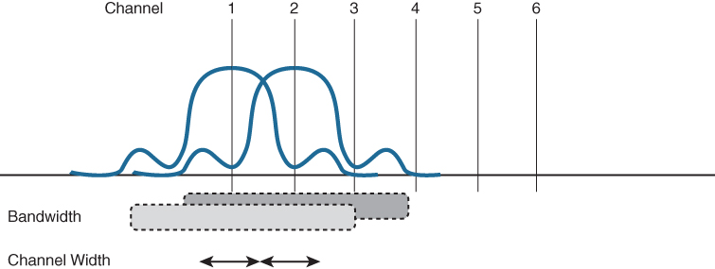
Understanding Basic Wireless Theory Understanding Frequency – Overlapping Channels
Ideally, the signal bandwidth should be less than the channel width so that a different signal could be transmitted on every possible channel, with no chance that two signals could overlap and interfere with each other.
When the signal bandwidth is wider than the channel assignment, the signals overlap each other, as shown in Figure 17-10. Because of this, signals on adjacent channels cannot possibly coexist without interfering with each other.
Signals must be placed on more distant channels to prevent overlapping, thus limiting the number of usable channels in the band.
Figure 17-10 Overlapping Channel Spacing

Slide 13
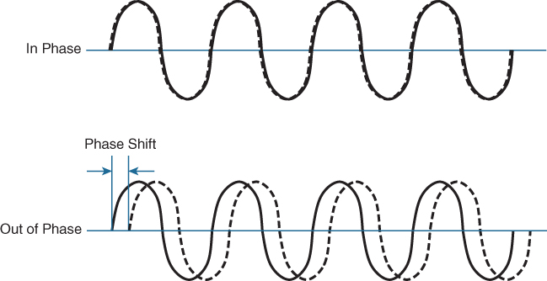
Understanding Basic Wireless Theory Understanding Phase
RF signals are very dependent upon timing because they are always in motion.
The phase of a signal is a measure of shift in time relative to the start of a cycle.
When two identical signals are produced at exactly the same time, their cycles match up and they are said to be in phase with each other. If one signal is delayed from the other, the two signals are said to be out of phase.
Signals that are in phase tend to add
together, whereas signals that are 180 degrees out of phase tend to cancel each other out.
Figure 17-11 Signals In and Out of Phase

Slide 14
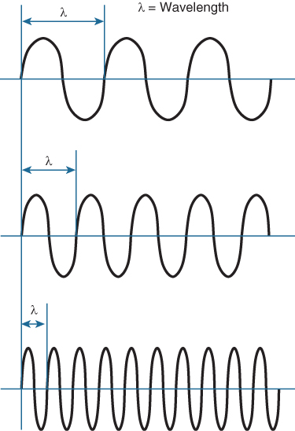
Understanding Basic Wireless Theory Measuring Wavelength
Wavelength is a measure of the physical distance that a wave travels over one complete cycle. Wavelength is usually designated by the Greek symbol lambda (λ).
Regardless of the frequency, RF waves travel
at a constant speed. In a vacuum, radio waves travel at exactly the speed of light; in air, the
velocity is slightly less than the speed of light.
Wavelength decreases as the frequency increases. As the wave cycles get smaller, they cover less distance.
Figure 17-12 Examples of Increasing Frequency
and Decreasing Wavelength

Slide 15
Understanding Basic Wireless Theory Understanding RF Power and dB
Use of the dB logarithmic functions:
The strength of a wave can be measured as its amplitude, the top to bottom peak.
The strength of an RF signal is usually measured by its power, in watts (W).
When power is measured in watts (W) or milliwatts (mW), it is considered to be an absolute power measurement.
Because absolute power values can fall anywhere within a huge range, from a tiny decimal number to hundreds, thousands, or greater values, we use logarithmic functions to transform exponential ranges into linear ones.
The decibel (dB) is a handy function that uses logarithms to compare one absolute measurement to another. It was originally developed to compare sound intensity levels, but it applies directly to power levels, too.

Slide 16


Understanding Basic Wireless Theory Understanding RF Power and dB (Cont.)
The following equation is used to calculate a dB value, where P1 and P2 are the absolute power levels of two sources:
P2 represents the source of interest, and P1 is usually called the reference value or the source of comparison. The difference between the two logarithmic functions can be rewritten as a single logarithm of P2 divided by P1, as follows:
The ratio of the two absolute power values is computed first; then the result is converted onto a logarithmic scale. The ratio or division form of the equation is the most commonly used in the wireless engineering world.

Slide 17
Understanding Basic Wireless Theory Understanding RF Power and dB (Cont.)
Important dB laws are as follows:
Law of Zero: A value of 0 dB means that the two absolute power values are equal. If the two power values are equal, the ratio inside the logarithm is 1, and the log10(1) is 0. This law is intuitive; if two power levels are the same, one is 0 dB greater than the other.
Law of 3s: A value of 3 dB means that the power value of interest is double the reference value; a value of −3 dB means the power value of interest is half the reference. When P2 is twice P1, the ratio is always 2. Therefore, 10log10(2) = 3 dB. When the ratio is 1/2, 10log10(1/2) = −3 dB.The Law of 3s is not very intuitive, but is still easy to learn. Whenever a power level doubles, it increases by 3 dB. Whenever it is cut in half, it decreases by 3 dB.
Law of 10s: A value of 10 dB means that the power value of interest is 10 times the reference value; a value of −10 dB means the power value of interest is 1/10 of the reference.
When P2 is 10 times P1, the ratio is always 10. Therefore, 10log10(10) = 10 dB.
When P2 is one tenth of P1, then the ratio is 1/10 and 10log10(1/10) = −10 dB.
The Law of 10s is intuitive because multiplying or dividing by 10 adds or subtracts 10 dB, respectively.

Slide 18
Understanding Basic Wireless Theory Understanding RF Power and dB (Cont.)
When absolute power values multiply, the dB value is positive and can be added. When the power values divide, the dB value is negative and can be subtracted. Table 17-3 summarizes the useful dB comparisons.
Table 17-3 Power Changes and Their Corresponding dB Values
Power Change | dB Value
= | 0 dB
× 2 | +3 dB
/ 2 | −3 dB
× 10 | +10 dB
/ 10 | −10 dB

Slide 19
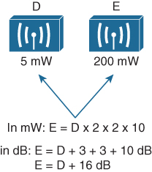
Understanding Basic Wireless Theory Example of Computing dB
Sources D and E have power levels 5 and 200 mW. Try to figure out a way to go from 5 to 200 using only × 2 or × 10 operations.
Using the x2 and x10 operations, double 5 to get 10, then double 10 to 20. Multiply by 10 to reach 200 mW. (E=D x 2 x 2 x 10)
Use the dB laws to replace the doubling and x10 with the dB equivalents. The result is E=D + 3 + 3 + 10 dB or E=D + 16 dB
Figure 17-17 Example of Computing dB
with Simple Rules

Slide 20

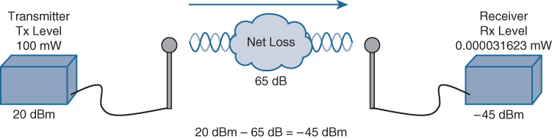
Understanding Basic Wireless Theory Understanding RF Power and dB
Beyond comparing two transmitting sources, a network engineer must be concerned about the RF signal propagating from a transmitter to a receiver. The dB formula to compare the received signal strength to the transmitted signal strength is:
The absolute power values at the transmitter and receiver can be converted to dBm, the results of which are shown in Figure 17-19. Notice that the dBm values can be added along the path: The transmitter dBm plus the net loss in dB equals the received signal in dBm.
Figure 17-19 Subtracting dB to Represent a Loss in Signal Strength

Slide 21
Understanding Basic Wireless Theory Measuring Power Changes Along the Signal Path
A transmitter, its antenna, and the cable that connects them are all discrete components that not only propagate an RF signal but also affect its absolute power level.
Transmitter power is usually a known value, expressed in mW.
When an antenna is connected to a transmitter, it provides some amount of gain to the resulting RF signal. An antenna’s gain is measured by comparing its performance with that of a reference antenna (usually an isotropic antenna), then computing a value in dB.
An isotropic antenna does not actually exist because it is ideal in every way. The isotropic antenna’s performance can be calculated according to RF formulas, making it a universal reference for any antenna.
Some signal loss occurs due to the physical qualities of the cable that connects an antenna to a transmitter, Cable vendors supply the loss values in dB per foot or meter of cable length for each type of cable manufactured.

Slide 22
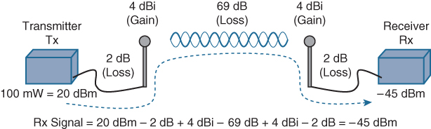
Understanding Basic Wireless Theory Measuring Power Changes Along the Signal Path (Cont.)
The effective isotropic radiated power (EIRP) is the actual power level that will be radiated from the antenna. This value is calculated as a combination of transmitter power, the loss from the length of cable, and the antenna gain. The formula to calculate EIRP: EIRP = Tx Power – Tx Cable + Tx Antenna. EIRP is regulated by government agencies in most countries, a signal cannot exceed the maximum allowable EIRP.
A link budget is the power levels across the entire path from transmitter to receiver. To calculate the received signal strength, begin with the transmitter power expressed in dBm, add or subtract the dB components along the signal path to find the signal strength that arrives at the receiver.
Figure 17-22 Example of Calculating Received Signal Strength

Slide 23
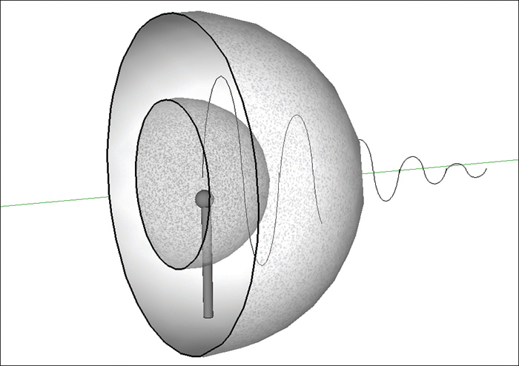
Understanding Basic Wireless Theory Free Space Path Loss
Whenever an RF signal is transmitted from an antenna, its amplitude decreases as it travels through free space.
Even if there are no obstacles in the path between the transmitter and receiver, the signal strength will weaken. This is known as free space path loss.
If the antenna is a point the RF data wave energy travels in every direction from the antenna. The wave that is produced takes the form of a sphere.
As energy is transmitted from the antenna, the sphere expands in free space.
Regardless of the antenna used, the amount of free space path loss through free space is consistent. Two facts:
Free space path loss is an exponential function; the signal strength falls off quickly near the transmitter but more slowly farther away.
The loss is a function of distance and frequency only.
Figure 17-23 Free Space Loss Due to Wave Spreading

Slide 24
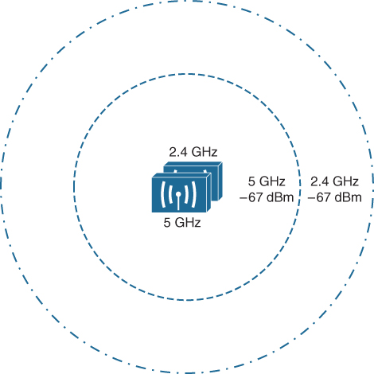
Understanding Basic Wireless Theory Free Space Path Loss (Cont.)
Free space path loss is greater in the 5 GHz band than it is in the 2.4 GHz band. In the equation, as the frequency increases, so does the loss in dB.
Figure 17-24 shows the range difference, where both transmitters have an equal EIRP. The dashed circles show where the effective range ends, at the point where the signal strength of each transmitter is equal.
Figure 17-24 Effective Range of 2.4 GHz
and 5 GHz Transmitters

Slide 25
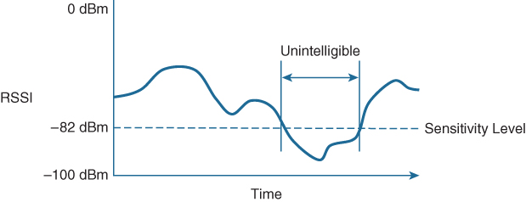
Understanding Basic Wireless Theory Power Levels at the Receiver
Receivers usually measure a signal’s power level according to the received signal strength
indicator (RSSI) scale.
The RSSI value is defined in the 802.11 standard as an internal 1-byte relative value ranging from 0 to 255, where 0 is the weakest and 255 is the strongest. The range of RSSI values can vary between one hardware manufacturer and another.
Every receiver has a sensitivity level, or a threshold that divides intelligible, useful signals from unintelligible ones. As long as a signal is received with a power level that is greater than the sensitivity level, chances are that the data from the signal can be understood correctly.
Figure 17-25 Example of Receiver Sensitivity Level

Slide 26
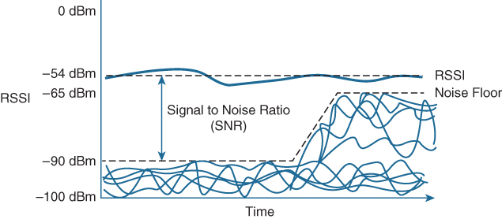
Understanding Basic Wireless Theory Power Levels at the Receiver (Cont.)
The RSSI value focuses on the expected signal alone, without regard to any other signals that may also be received. All other signals that are received on the same frequency as the one you are trying to receive are simply viewed as noise. The noise level, or the average signal strength of the noise, is called the noise floor.
The difference between the signal and the noise is called the signal-to-noise ratio (SNR), measured in dB. A higher SNR value is preferred.
Figure 17-26 Example of a Changing Noise Floor and SNR

Slide 27
Carrying Data Over an RF Signal
Modulation is the process by which a carrier signal is changed in order to carry a data signal.
Modulation schemes can alter frequency, phase or amplitude of the signal to indicate the zeroes and ones within the data transmission.

Slide 28
Carrying Data Over an RF Signal Modulation
To add data to the RF signal, the frequency of the original carrier signal must be preserved. Therefore, there must be some scheme of altering some characteristic of the carrier signal to distinguish a 0 bit from a 1 bit.
Altering the carrier signal is known as modulation, where the carrier signal is modulated or changed according to some other source. At the receiver, the process is reversed; demodulation interprets the added information based on changes in the carrier signal.
RF modulation schemes generally have the following goals:
Be reasonably immune to interference and noise
Be practical to transmit and receive
Due to the physical properties of an RF signal, a modulation scheme can alter only the following attributes:
Frequency, but only by varying slightly above or below the carrier frequency
Phase
Amplitude

Slide 29
Carrying Data Over an RF Signal Modulation (Cont.)
The modulation techniques require some amount of bandwidth centered on the carrier frequency due to the rate of the data being carried and partly due to the overhead from encoding the data and manipulating the carrier signal.
Narrowband transmissions, such as audio signals over an AM or FM radio, have a relatively low bit rate and little overhead.
Wireless LANs must carry data at high bit rates, requiring more bandwidth for modulation. Data being sent is spread out across a range of frequencies, known as spread spectrum. Two common spread-spectrum categories:
Direct sequence spread spectrum (DSSS): Used in the 2.4 GHz band, where a small number of fixed, wide channels support complex phase modulation schemes and somewhat scalable data rates, making it more resilient to disruption.
Orthogonal Frequency Division Multiplexing (OFDM): Used in both 2.4 and
5 GHz bands, where a single 20 MHz channel contains data that is sent in parallel
over multiple frequencies. Each channel is divided into many subcarriers (also called subchannels or tones); both phase and amplitude are modulated with quadrature amplitude modulation (QAM) to move the most data efficiently.

Slide 30
Carrying Data Over an RF Signal Maintaining AP - Client Compatibility
Each step in the 802.11 evolution involves an amendment to the standard, defining things like modulation and coding schemes that are used to carry data over the air.
A summary of common amendments to the 802.11 standard, along with the permitted bands, supported data rates, and channel width, is shown in Table17-4.
Table 17-4 A Summary of Common 802.11 Standard Amendments
Standard | 2.4 GHz? | 5 GHz? | Data Rates Supported | Channel Widths Supported
802.11b | Yes | No | 1, 2, 5.5, and 11 Mbps | 22 MHz
802.11g | Yes | No | 6, 9, 12, 18, 24, 36, 48, and 54 Mbps | 22 MHz
802.11a | No | Yes | 6, 9, 12, 18, 24, 36, 48, and 54 Mbps | 20 MHz
802.11n | Yes | Yes | Up to 150 Mbps* per spatial stream, up to 4 spatial streams | 20 or 40 MHz
802.11ac | No | Yes | Up to 866 Mbps per spatial stream, up to 4 spatial streams | 20, 40, 80, or 160 MHz
802.11ax | Yes* | Yes* | Up to 1.2 Gbps per spatial stream, up to 8 spatial streams | 20, 40, 80, or 160 MHz
*802.11ax is designed to work on any band from 1 to 7 GHz, provided that the band is approved for use.

Slide 31
Carrying Data Over an RF Signal Maintaining AP-Client Compatibility
Newer Wi-Fi Standards include the following:
The 802.11n amendment was published in 2009 in an effort to scale wireless LAN performance to a theoretical maximum of 600 Mbps. The amendment was unique because it defined a number of additional techniques known as high throughput (HT) that can be applied to either the 2.4 or 5 GHz band.
The 802.11ac amendment was introduced in 2013 and brought even higher data rates through more advanced modulation and coding schemes, wider channel widths, greater data aggregation during a transmission, and so on. 802.11ac is known as very high throughput (VHT) wireless and can be used only on the 5 GHz band.
The 802.11ax amendment, also known as Wi-Fi 6 and high efficiency wireless, aims to change the principle that only one device can claim airtime at a time by permitting multiple devices to transmit during the same window of air time. This becomes important in areas that have a high density of wireless devices, all competing for air time and throughput. 802.11ax uses OFDM Access (OFDMA) to schedule and control access to the wireless medium, with channel air time allocated as resource units that can be used by multiple devices simultaneously.

Slide 32
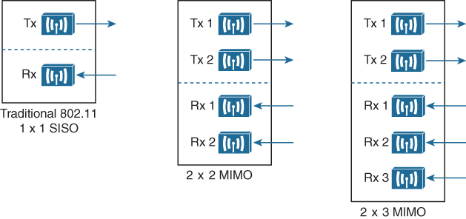
Carrying Data Over an RF Signal Using Multiple Radios to Scale Performance
Before 802.11n, wireless devices used a single transmitter and a single receiver. In other words, the components formed one radio, resulting in a single radio chain. This is also known as a single-in, single-out (SISO) system.
One secret to the better performance of 802.11n, 802.11ac, and 802.11ax is the use of multiple radio components, forming multiple radio chains. This is known as a multiple-input, multiple-output (MIMO) system.
Figure 17-28 Examples of SISO and MIMO Devices

Slide 33
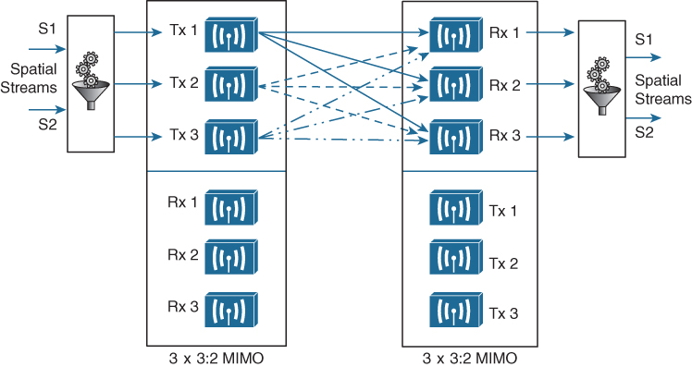
Carrying Data Over an RF Signal Spatial Multiplexing
To increase data throughput, data can be multiplexed or distributed across two or more radio chains—all operating on the same channel, but separated through spatial diversity. This is known as spatial multiplexing.
Spatial multiplexing requires a good deal of digital signal processing on both the transmitting and receiving ends. This pays off by increasing the throughput over the channel; the more spatial streams that are available, the more data that can be sent over the channel.
When the sender and receiver have mismatched spatial stream support, they negotiate the wireless connection and use the lowest number of special streams that they have in common.
Figure 17-29 Spatial Multiplexing Between Two 3×3:2 MIMO Devices

Slide 34
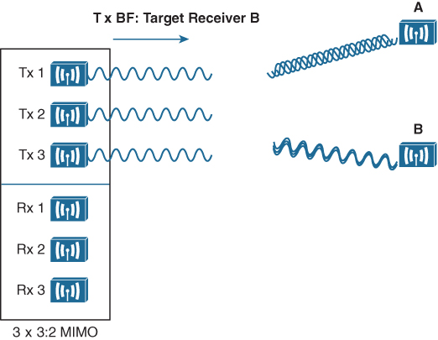
Carrying Data Over an RF Signal Transmit Beamforming
The 802.11n, 802.11ac, and 802.11ax amendments offer a method to customize the transmitted signal to prefer one receiver over others. By leveraging MIMO, the same signal can be transmitted over multiple antennas to reach specific client locations more efficiently.
With transmit beamforming (T×BF), the phase of the signal is altered as it is fed into each transmitting antenna so that the resulting signals will all arrive in phase at a specific receiver. Figure 17-30 shows a device on the left using transmit beamforming to target device B on the right.
Figure 17-30 Using Transmit Beamforming to Target
a Specific Receiving Device

Slide 35
Carrying Data Over an RF Signal Maximal - Ration Combining
When an RF signal is received on a device, it may be degraded or distorted due to a variety of conditions. If that same signal was transmitted over multiple antennas, as in the case of a MIMO device, then the receiving device can attempt to restore it to its original state.
The receiving device can use multiple antennas and radio chains to receive the multiple transmitted copies of the signal. One copy might be better than the others, or one copy might be better for a time, and then become worse than the others. Maximal-ratio combining (MRC) can combine the copies to produce one signal that represents the best version at any given time.

Slide 36
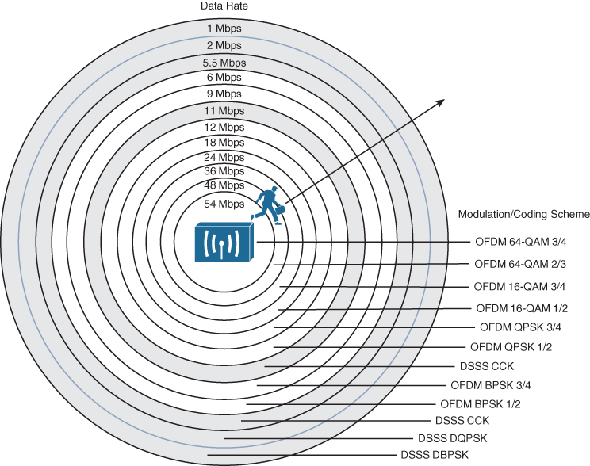
Carrying Data Over an RF Signal Dynamic Rate Shifting
Figure 17-31 illustrates dynamic rate shifting (DRS) operation on the 2.4 GHz band.
Each concentric circle represents the range supported by a particular modulation and coding scheme. Notice that the white circles denote OFDM modulation (802.11g), and the shaded circles contain DSSS modulation (802.11b).
Each move of the receiver away from the transmitter, into a larger concentric circle, causes a dynamic shift to a reduced data rate, in an effort to maintain the data integrity to the outer reaches of the transmitter’s range.
Figure 17-31 Dynamic Rate Shifting as a Function of Range

Slide 37
Prepare for the Exam

Slide 38
Prepare for the Exam Key Topics for Chapter 17
Topics
dB definition
Important dB laws to remember
EIRP calculation
Free space path loss concepts
Effective Range of 2.4 GHz and 5 GHz Transmitters
Example of receiver sensitivity level
Modulation scheme output
Summary of common 802.11 standard amendments
Dynamic rate shifting as a function of range

Slide 39
Prepare for the Exam Key Terms for Chapter 17
Term
Amplitude | Demodulation
Band | Direct sequence spread spectrum (DSSS)
Bandwidth | Dynamic rate shift (DRS)
Carrier signal | Effective isotropic radiated power (EIRP)
Channel | Frequency
dBd | Hertz (Hz)
dBi | In phase
dBm | Isotrophic antenna
Decibel (dB) | Link budget

Slide 40
Prepare for the Exam Key Terms for Chapter 17 (Cont.)
Term
Maximal-ratio combining (MRC) | Received signal strength indicator (RSSI)
Modulation | Sensitivity level
Narrowband | Signal-to-noise ration (SNR)
Noise floor | Spatial multiplexing
Orthogonal Frequency Division Multiplexing (OFDM) | Spatial stream
Out of phase | Spread spectrum
Phase | Transmit beamforming (TxBF)
Quadrature amplitude modulation (QAM) | Wavelength
Radio frequency (RF)

